Slide 1



WORLD BANK PROJECT SUMMARY
Economic Value Added Exploration by Xiaohui (Sophie) Li

Slide 2
ECONOMIC VALUE ADDED

Slide 3
ECONOMIC VALUE ADDED
EVA assesses the performance of a company and its management through the idea that a business is only profitable when it creates wealth and returns for shareholders, thus requiring performance above a company's cost of capital.
EVA = NOPAT - (Total Assets - Current Liabilities) * WACC
EVA spread = ROIC - WACC
WACC = D/V * Kd + E/V * Ke
NOPLAT: Net operating profit after taxes
ROIC = NOPLAT/invested capital
Invested capital = Total Debt + Total Shareholders’ Equity + Allowance for Doubtful Accounts + Deferred Tax Liabilities + Accrued Income Taxes
Data from Bloomberg, latest EVA available from companies’ latest filings

Slide 4
DATASET EXPLORATION

Slide 5
DATASET DESCRIPTION
1. Supplier-Customer relation Dataset 78384 firms
2. Entity Information
3. Finance Information 45636 firms
Supplier & Customer Identification Relationship Identification Relation Start and End Date
2.1 Complete Info: 54347 firms General Description Geographic Info ISIN & Ticker Info
General Description WACC related Data Industry Data ISIN & Ticker Info
2.2 Partial Info: 78384 firms General Description Geographic Info

Slide 6
TAKEAWAYS FROM DATASETS
Dataset 1 and dataset 2.2 should match, but dataset 2.2 doesn’t have ISIN or Ticker to find financials for EVA study. Merging dataset 1 and dataset 2.2 have 0 observation lost. Factset ID could not be used in Worldscope or Bloomberg.
Dataset 1 only has very few revenue related to specific relationship, which makes it hard to explore the importance of a certain partner to a firm.
Dataset 2.1 doesn’t cover all firms in dataset 1, only 28079 out of 78384 firms can be matched, 64% observations loss due to incomplete data
We can only find financial data for public companies, merging dataset 2.1 and dataset 3 results in ~40% observation loss due to firm nature (private, subsidiaries, government etc.). Totally, we were able to find 28% firms’ EVA related info (22144) in the relationship dataset.

Slide 7
RESEARCH APPROACH
Hypothesis: 1. A firm’s EVA is related to it’s suppliers’ and/or customers’ EVA; 2. A firm’s EVA is related to it’s suppliers’ and/or customers’ relation duration; 3. The above correlation might be different in different regions and industries
Methodology 1. Create info Dataset 1 with every firm’s every supplier and every customer; 2. Assign 10 EVA class to each firm based on quantile of EVA; 3. Use EVA, EVA Spread and EVA class respectively to study correlations on EVA; 4. Descriptive study on firms’ EVA distribution, partner’s EVA distribution, region and industry trend; 5. Create subsets of Dataset 1 and use OLS regression to study correlations
Dataset 2 & 3: every firm’s all suppliers’ average EVA; customers’ average EVA
Dataset 4: find firms’ with both suppliers’ info and customers’ info and regress firm’s EVA against two independent variables (suppliers’ EVA, customers’ EVA)
6. Study correlations for different region and industries

Slide 8
DATA VISUALIZATION

Slide 9
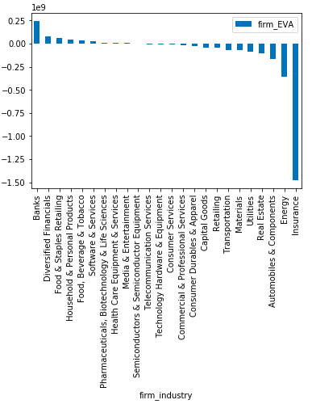
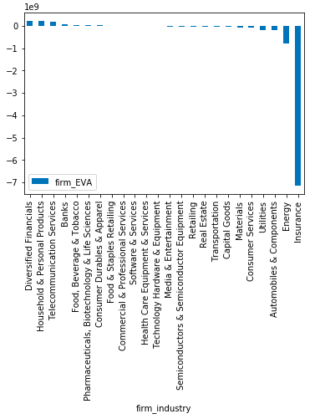
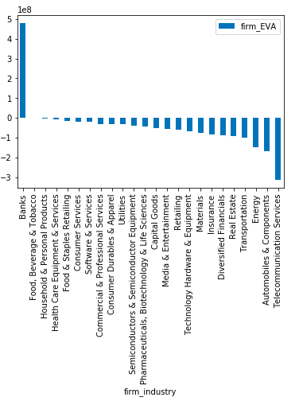
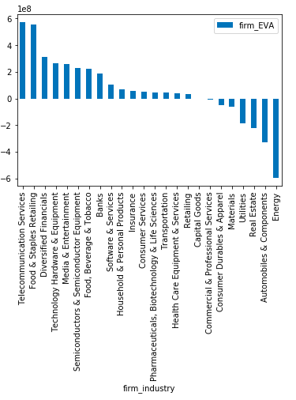
AVERAGE EVA BY INDUSTRY & REGION
Global
ECA
EAP
NOAM
ECA region’s insurance industry dragged the EVA down; EAP has one prominent industry (bank), others are lackluster; NOAM has a balanced EVA distribution through different industries.

Slide 10
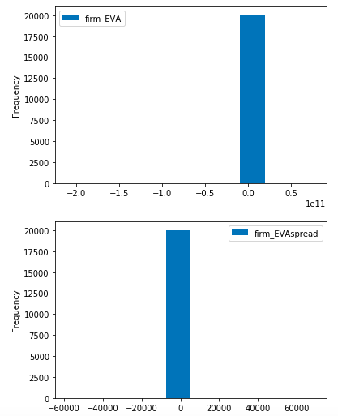
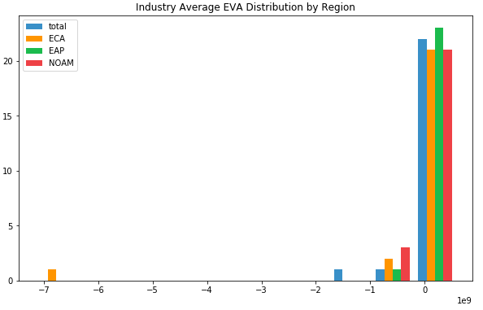
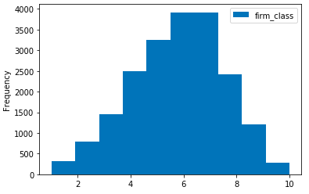
EVA DISTRIBUTION BY FIRM & INDUSTRY
Industries’ distribution is skewed by the insurance industry EVA from ECA region
Firm’s EVA and EVA Spread are hard to distinguish before reassign to EVA classes

Slide 11
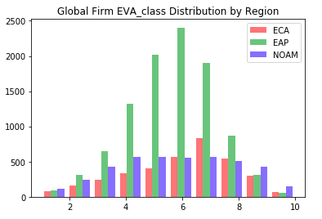
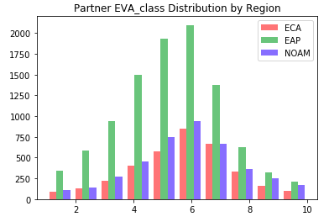
EVA CLASS DISTRIBUTION BY REGION
EAP has twice as many firms as ECA and/or NOAM, it is an emerging economy
ECA firms have bell shaped distribution around EVA class 7(-2.5~9.9m); EAP firms are around EVA class 6(-14~-2.5m); and NOAM firms are almost flat from EVA class 4 (-124~-42m) to 8 (9.9~104m).
NOAM has the largest amount of star firms and small under performing firms, once a firm’s future is promising, it will be bought by large firms to boost growth. Capital also seems to be more tolerant to underperforming firms in NOAM region.
Partners for all regions show bell shaped distribution. Because partners tend to from all regions in the world.

Slide 12
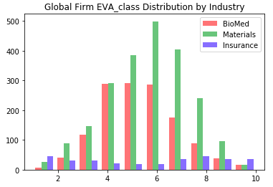
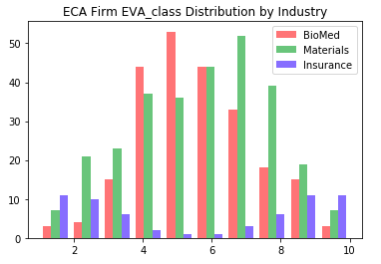
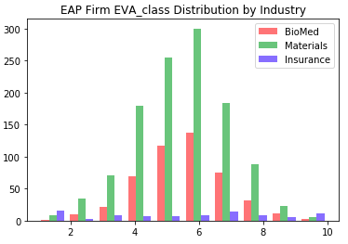
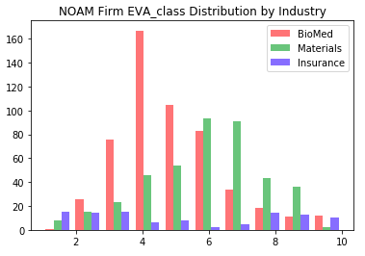
EVA CLASS DISTRIBUTION BY INDUSTRY
Global EVA class is distributed normally for Materials Industry around 6 (-14~-2.5M), skewed to low EVA class for BioMed Industry and reverse normal distribution for Insurance Industry
EAP region has a large# of companies in Material industry.
ECA region’s material industry has a longer left tale, and BioMed has a longer right tale. Material Industry in general has higher EVA class than Bio industry. Insurance industry are reverse normally distributed.
NOAM has most BioMed companies in the three region and most of them are low in EVA class (unprofitable)

Slide 13
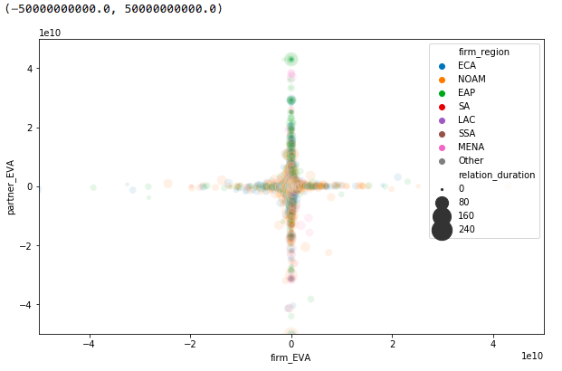
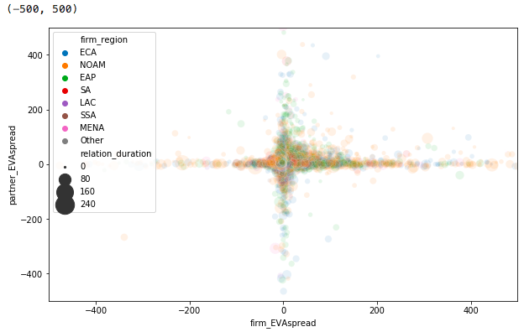
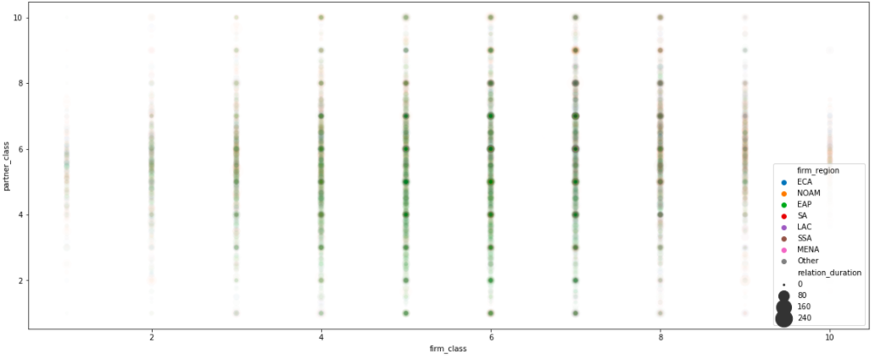
RELATION BETWEEN FIRM’S EVA VS. ITS PARTNER’S EVA
There is no clear correlation between a firm’s EVA, EVA spread or EVA class with its partners same measures.
Some signs of very week positive correlations in all measures

Slide 14
TAKEAWAYS FROM DATA VISUALIZATION
Most firms have EVA in a certain ranges, few firms have extreme EVAs, making the histogram hard to distinguish. Assigning different classes based on quantile EVA can normally distribute global EVA class.
EVA class for different industries and different regions have different distribution pattern. Mature industries (like materials) distribution tend to centered around higher EVA than innovative industries (like biomed). Insurance industry has very weird distribution with high on two opposite extreme cases of EVA classes. Especially significant in ECA region, is it too big to fail?
Both high EVA firms percentage and median low EVA firms percentage in NOAM region is higher than other areas, maybe due to frequently using M&A strategies.
There is no clear correlation between firm’s EVA and its partner’s EVA. But some vague positive correlation can be inferred.

Slide 15
REGRESSION ANALYSIS

Slide 16
REGRESSION ANALYSIS
Datasets
All firms with undistinguished customers & suppliers
All firms with only their suppliers
All firms with only their customers
All firms have both suppliers and customers with their suppliers and customers
Variables
Hypothesis I: Firm’s EVA is related to its partner’s EVA and relation duration
Dependent variables: firm’s EVA class, EVA, EVA spread
Independent variables: partner’s EVA class, EVA, EVA spread, relation duration
2. Hypothesis II: Firm’s EVA is related to its EVA spread
Dependent variables: firm’s EVA; Independent variables: firm’s EVA spread
Hypothesis III: Firm supplier’s duration is related to its customer’s duration
Dependent variables: supplier’s duration; Independent variables: customer’s duration
Industry and Region of interest
ECA, EAP and NOAM regions
BioMed, Materials and Insurance industries

Slide 17
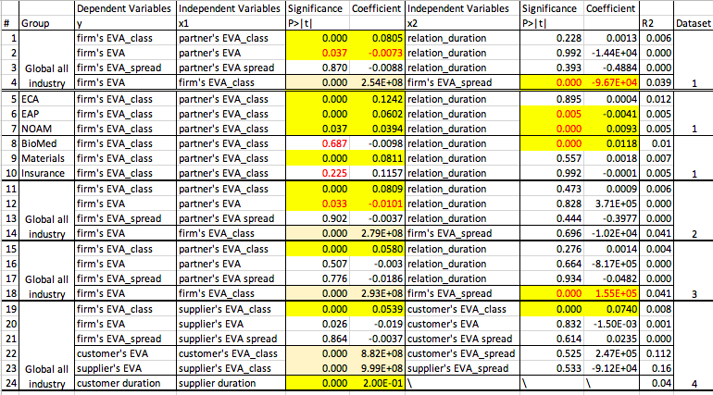
RESULTS

Slide 18
TAKEAWAYS FROM REGRESSION ANALYSIS
Firm’s EVA class has positive correlation with it’s partner’s EVA class in all firm’s data. And it has no correlation with it’s partner’s duration. In most cases, R square is very small, meaning data is very far apart distributed as shown in data visualization section.
Correlation can be identified using EVA class, but if EVA or EVA spread is used instead, correlation is almost disappeared.
It is expected to have a positive correlation between EVA and EVA spread, however, in reality the correlation is usually not significant and can be negative or positive.
The strongest correlation is between firm’s supplier duration with its customer duration, indicating the duration may be related to firm’s consistent strategy.
Relation significance is observed in different regions (EAP & NOAM), but trend is opposite. Similarly, relation significance can be found in different industries with opposite coefficient signs.
EVA class significance also can be found in certain industries, but the directions are all the same. And this leads to the overall significant positive correlation across industries and regions.

Slide 19

FUTURE WORK
Some indications from the correlation discrepancy across industries for further exploration: (regression is run for all industries and all regions, as shown in extra graphs)
Firms in service based industries tend to have less correlation with their partners;
Firms in manufacturing industries tend to have more correlation with their partners;
Firms in government highly subsidized industries tend to disrupt the expected correlations with their partners.

